Slide 1
LEGAL Corpus LINGUISTICS
Hands-on Introduction
Łucja Biel
University of Warsaw
l.biel@uw.edu.pl

Slide 2
Please register
https://www.english-corpora.org/
Sketch Engine https://www.sketchengine.eu/ → Free Trial

Slide 3
What is a corpus?
"A large collection of authentic texts that have been gathered in electronic form according to a specific set of criteria” (Bowker and Pearson 2002:9)
Machine-readable representative collection of naturally occurring language assembled for the purpose of linguistic analysis which can be analyzed with dedicated software (McEnery et al. 2006: 4-5)

Slide 4
Types of corpora
Big v small
Comparable and parallel
Written, audio, video & audio, audio & transcribed spoken texts; audio files
Monolingual v bilingual v multilingual
Synchronic v diachronic (historical)
General / specialised (special-purpose), learner corpora
National corpora
Static sample corpus v dynamic monitor corpus

Slide 5
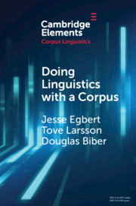
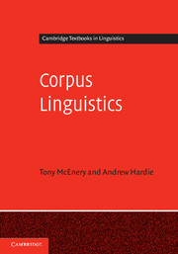
CORPUS LINGUISTICS

Slide 6
Corpus linguistics
Systematic software-assisted analysis of corpora to address specific research questions (Egbert et al. 2020)
One of mainstream methods in linguistics, compared to the invention of telescopes in astronomy
Helps uncover patterns that are not readily visible with a naked eye
Repeated events are significant → cognitive salience (Stubbs 2004: 111).
Scales up research and accelerates data extraction & analysis
Notes:
The term corpus linguistics used first in the 1980s (G. Leech)
Language corpora BC: shoe-box corpora; methodology used before computers in the pre-Chomskyan period (Boas, Sapir, Newman, Bloomfield, Pike or Otto Jespersen

Slide 7
Growing popularity of corpora
Technological progress (e.g. hardware);
Methodological progress (concordancing software, programming languages, statistics);
Scholars’ interest in objective, quantifiable, replicable and exhaustive data;
Theoretical developments in functional approaches to language (cognitive, social and communicative aspects of language)
(Gries and Newman 2013: 257)

Slide 8
Corpus linguistics
It is mainly a quantitative method but it also integrates qualitativeness (triangulation) → the big picture usually supplemented by qualitative analysis
Used as a method in other disciplines in humanities and social sciences: law, philosophy, history, psychology, sociology, law, economics

Slide 9
LAW & CORPORA

Slide 10
Corpora, CORPUS LINGUISTICS & law
Corpus & CL
Lexicographic tool in judicial practice to determine ordinary meaning
Research tool to study law and legal language

Slide 11
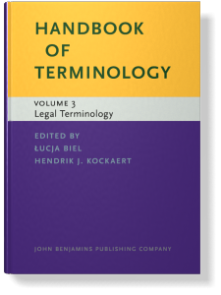
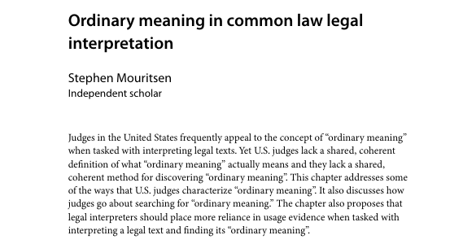
Corpus as A LEGAL interpretation tool
US interpretation rules: ordinary meaning – assigning standard rather than technical meaning to the statutory wording
Corpora to base legal interpretation in a „scientific method” to determine the ordinary meaning of words or phrases in judicial decision-making in the context of statutory interpretation instead of relying on intuition or dictionary definitions (Mouritsen, 2017).

Slide 12
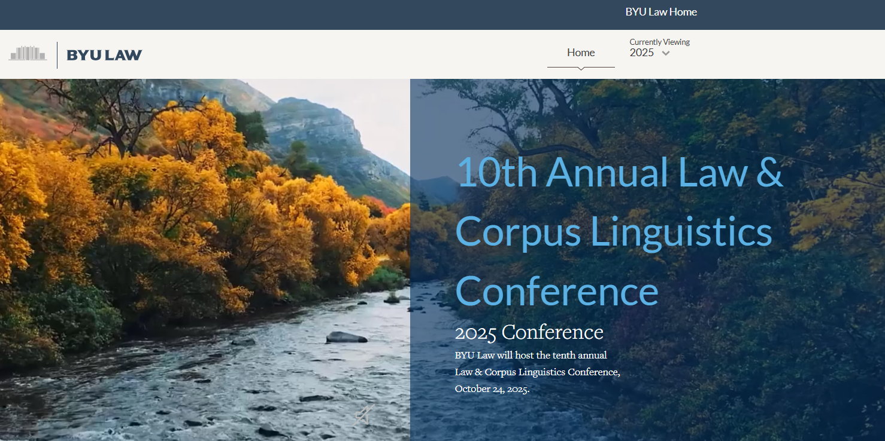
9th Annual Law & Corpus Linguistics Conference
Law & Corpus Linguistics Conference | 2025 Home

Slide 13
CORPUS RESEARCH on LEGAL LANGUAGE
Collaboration between linguists and legal scholars
Comparative legal linguistics: Eurolects
Features of legal language:
genre markers
deontic modality
argumentative patterns & epistemic modality in judicial language
legal terminology and (lack of) consistency
use of legal language in various legal contexts
Studies into multilingual law (McAuliffe, Hamann & Vogel, Biel, Prieto Ramos, Pontrandolfo)

Slide 14
EXAMPLES OF LEGAL CORPORA
Data Collections | SOULL - Sources of Language and Law
The EU Case Law Corpus (K.McAuliffe): Corpus Query interface (bham.ac.uk)
EUR-Lex judgments (Sketchengine)
DGT Translation Memory (Sketchengine)
British Parliamentary Debates (Sketchengine)
SCOTUS – Corpus of US Supreme Court Opinions English-Corpora: Supreme Court
The Old Bailey Corpus – a balanced subset of the digitalised proceedings from 1720 to 1913 http://www.uni-giessen.de/oldbaileycorpus/search.html

Slide 15
Working with existing corpora
Corpus of US Supreme Court Opinions https://www.english-corpora.org/scotus/
Rule #1: Know your corpus!
Rule #2: Play with the corpus!
How have the use of privacy and constitutional changed over the decades?
Find the collocates and compare the use of illegal and unlawful.

Slide 16
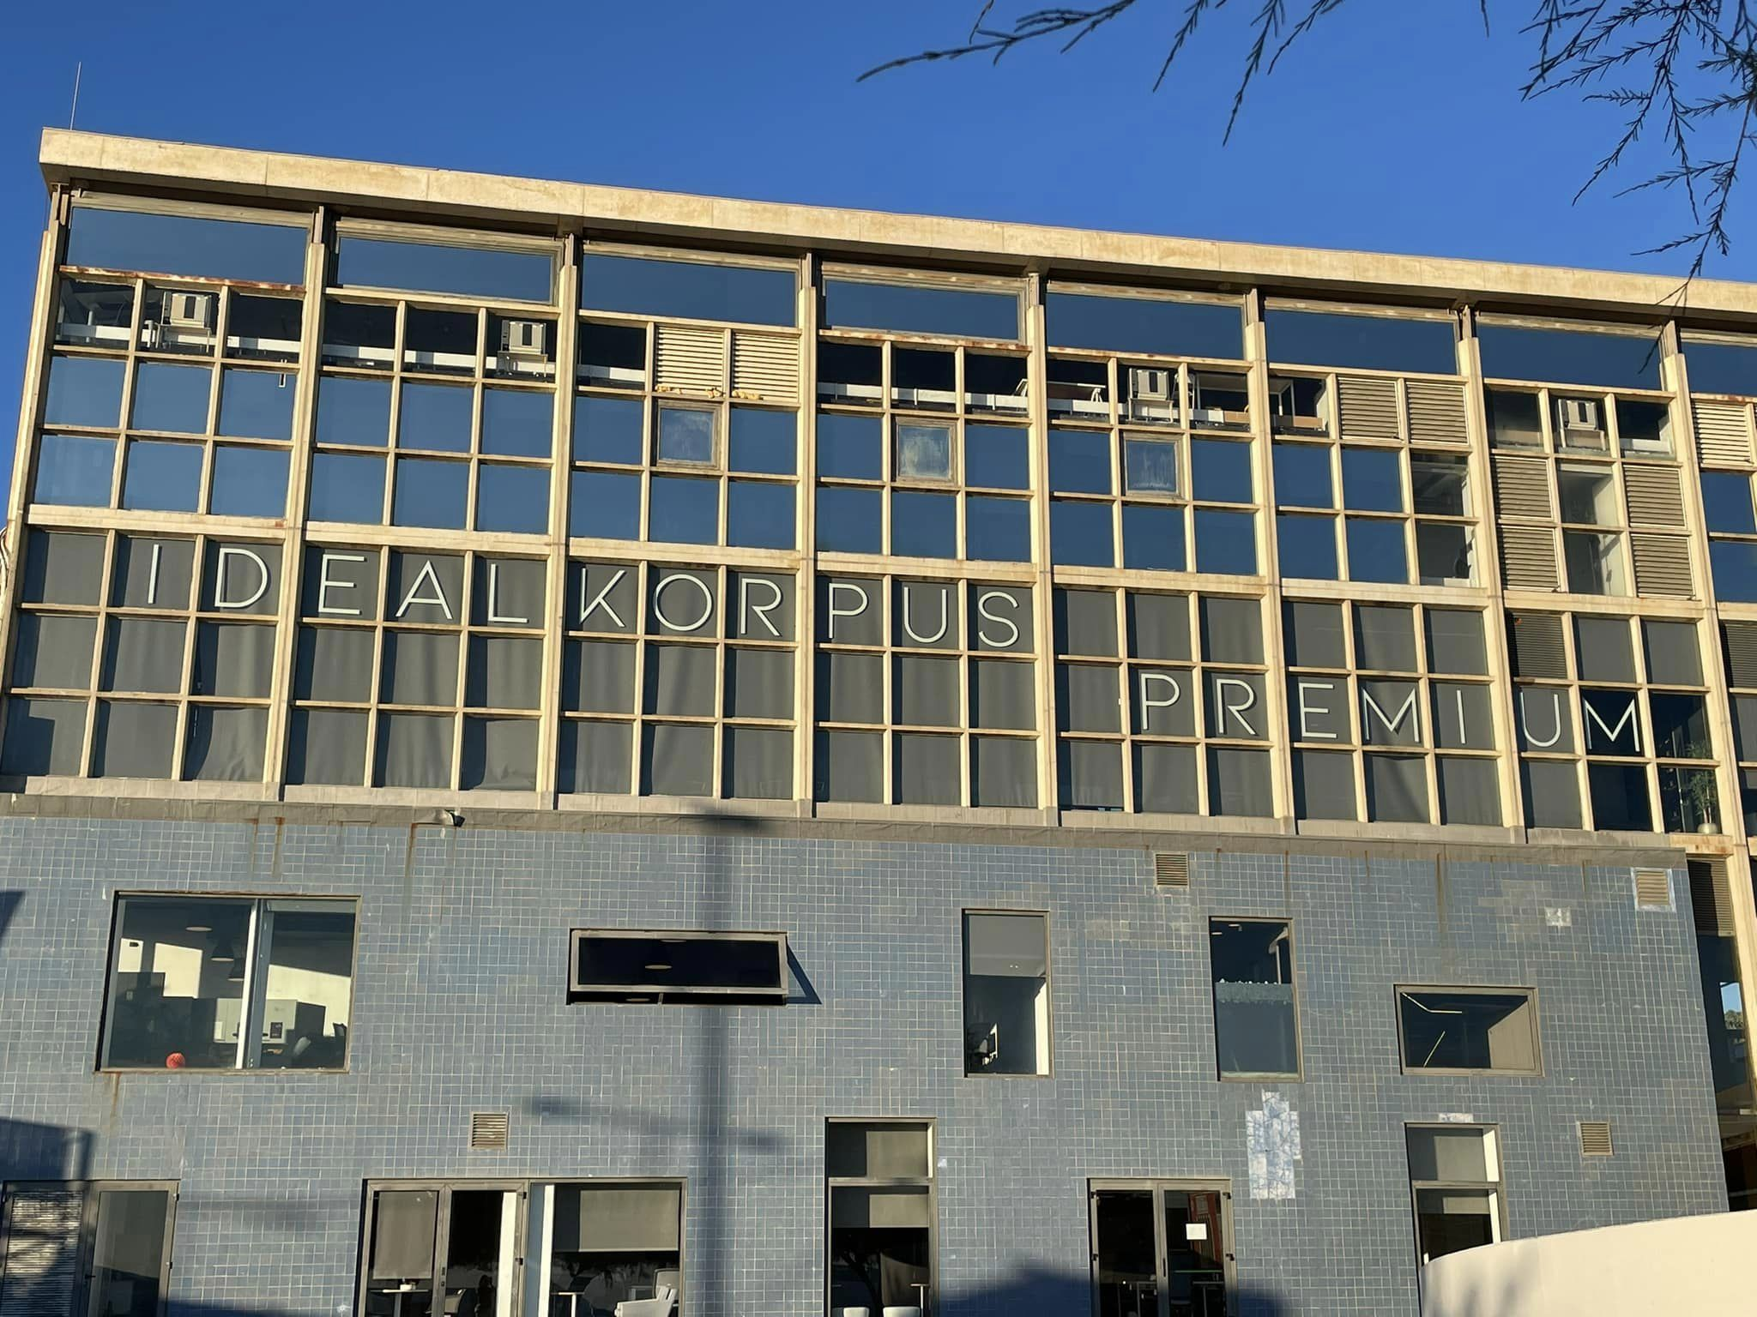
DESIGNING YOUR OWN CORPUS

Slide 17
Corpus DESIGN
Representativeness (a corpus as a sample of language/population)
Balance
Comparability
Sampling frame („to secure a sample which, subject to limitations of size, will reproduce the characteristics of the population, especially those of immediate interest, as closely as possible”, Yates 1965: 9)
Purpose / research question

Slide 18
Corpus design CRITERIA
Corpus type
Size (how large is large?)
Number of texts
Sampling: full texts or extracts
Subject
Text type
Authorship
Publication date
Language
Other: file type, file naming conventions, metadata

Slide 19
CORPUS ANALYSIS

Slide 20
Corpus analysis software
Sketchengine (1 month free; 8 EUR per month nonacademic use), UTF8 txt files https://www.sketchengine.eu/
#LancsBox (freeware) http://corpora.lancs.ac.uk/lancsbox/
AntConc & other tools (freeware), UTF8 txt files http://www.laurenceanthony.net/software.html
Wordsmith Tools (free 9.0; 50 GBP – 7.0), Unicode files https://www.lexically.net/wordsmith/version4/
Notes:
SketchEngine – based in Brno

Slide 21
BASIC Corpus Analysis Techniques
Wordlists
Alphabetical lists
Frequency-ranked lists and dispersion
Keywords
Lists of clusters
KWIC Concordance
Collocates and association measures; semantic prosodies
Measures: average sentence/word length; (standardized) type/token ratio; lexical density

Slide 22
SKETCH ENGINE
Log into Sketch Engine
Compile a corpus (POS-tagging, lemmatization)→ EU Directive Corpus
Corpus info
Extract a wordlist
Analyse concordance lines → contract, consumer
Word Sketch → contract, consumer
Keywords
N-grams

Slide 23
Keywords
Keyword – word that is found to be outstanding in its frequency in the focus corpus with reference to its frequency in another, generally larger corpus (reference corpus); become cognitively salient through their repetitive, unusually frequent use
Difference mindset (P.Baker)

Slide 24
KWIC concordance
A list of all the occurrences of a specified word or expression in a corpus, set in the middle of one line of context each. KWIC concordances help identify collocates
Collocates – words which occur in the neighbourhood (co-text) of the search word

Slide 25
N-grams / lexical bundles
Clusters – words which are found repeatedly together in sequence; recurrent expressions regardless of their idiomacity, and regardless of their structural status
N-grams, lexical bundles, p-frames (phrase-frames), multi-word units, conversational routines, fixed expressions
2-gram: data privacy
3-gram: rule of law
6-gram: shall ensure that the Member States

Slide 26
CORPUS LINGUISTICS
AS A RESEARCH METHOD

Slide 27
Types of CORPUS RESEARCH
Corpus-based
Corpus-driven
Corpus-assisted; corpus-informed

Slide 28
Advantages
CL: A scientific method of linguistic analysis (Brezina 2018): IT gives priority to observation over intuition (Stubbs 2004: 107-8)
corpora as diagnostic and analytical tools
reduced speculation and subjectivity (counting „is the least contestable mode of analysis” Holmes)
authenticity of data; new empirical data - big data; different type of data (patterns, n-grams, frequencies)
the potential to verify research hypotheses systematically and based on more extensive material
less error-prone: “computers provide consistent, reliable analyses; they do not change their minds or become tired during an analysis” (Biber and Jones 2009: 1287)

Slide 29
Disadvantages
problems with representativeness and balance: “any corpus is a compromise between the desirable and the feasible” (Stubbs 2004: 113)
any claims and generalisations we make about language are representative of the language sample we research, not of the entire language
Quantitative research: You see the forest, but you don’t see the trees.

Slide 30
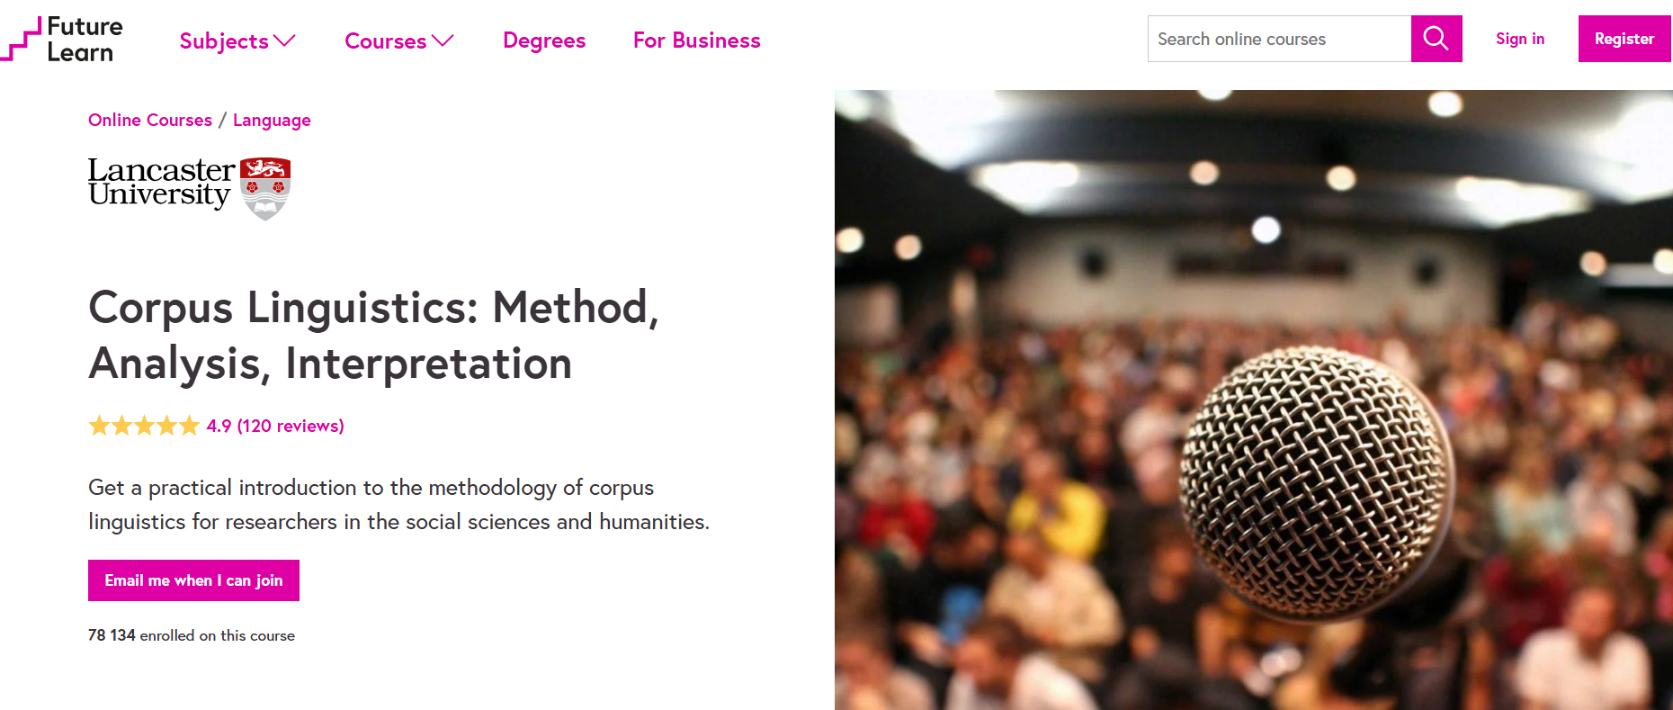
University of Lancaster – FutureLearn
https://www.futurelearn.com/courses/corpus-linguistics

Slide 31
Normalisation and Statistical significance
University of Lancaster
http://ucrel.lancs.ac.uk/llwizard.html
Vaclav Brezina (2018) Statistics in Corpus Linguistics. A Practical Guide. Oxford: OUP.
http://corpora.lancs.ac.uk/stats/

Slide 32
Parallel CORPUS
https://www.juremy.com/about/

